Slide 1
Business Process – Accounts Payable

Slide 2
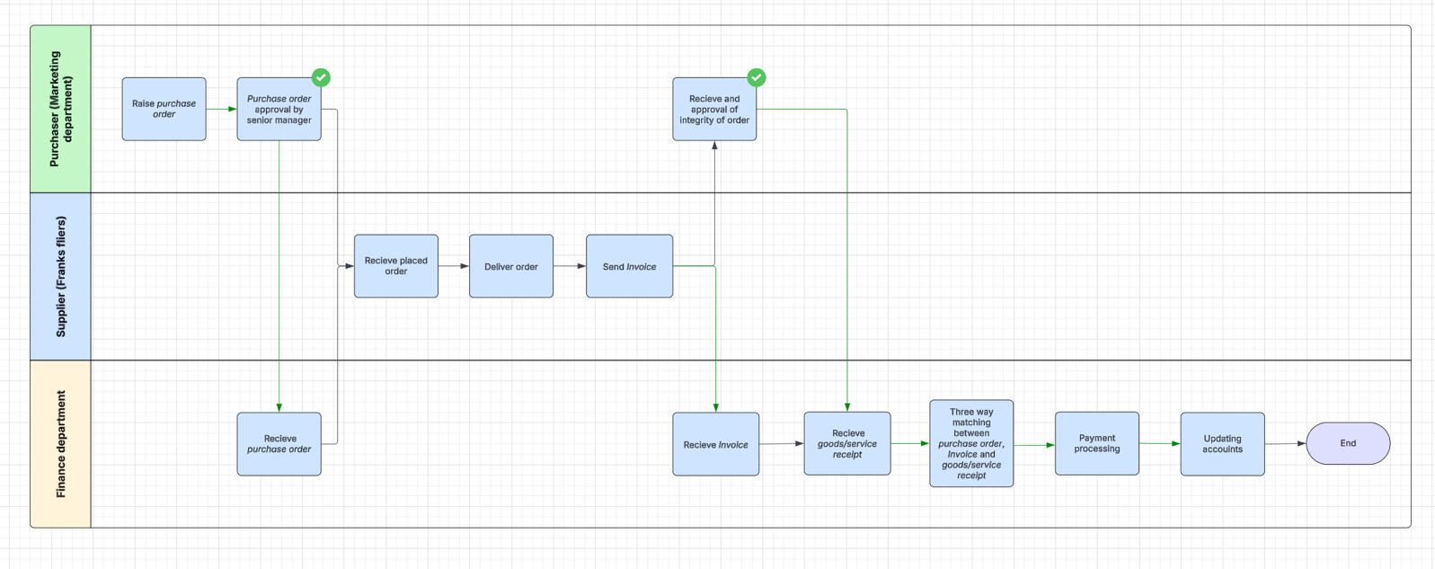
Accounts Payable Business Process 1.0

Slide 3
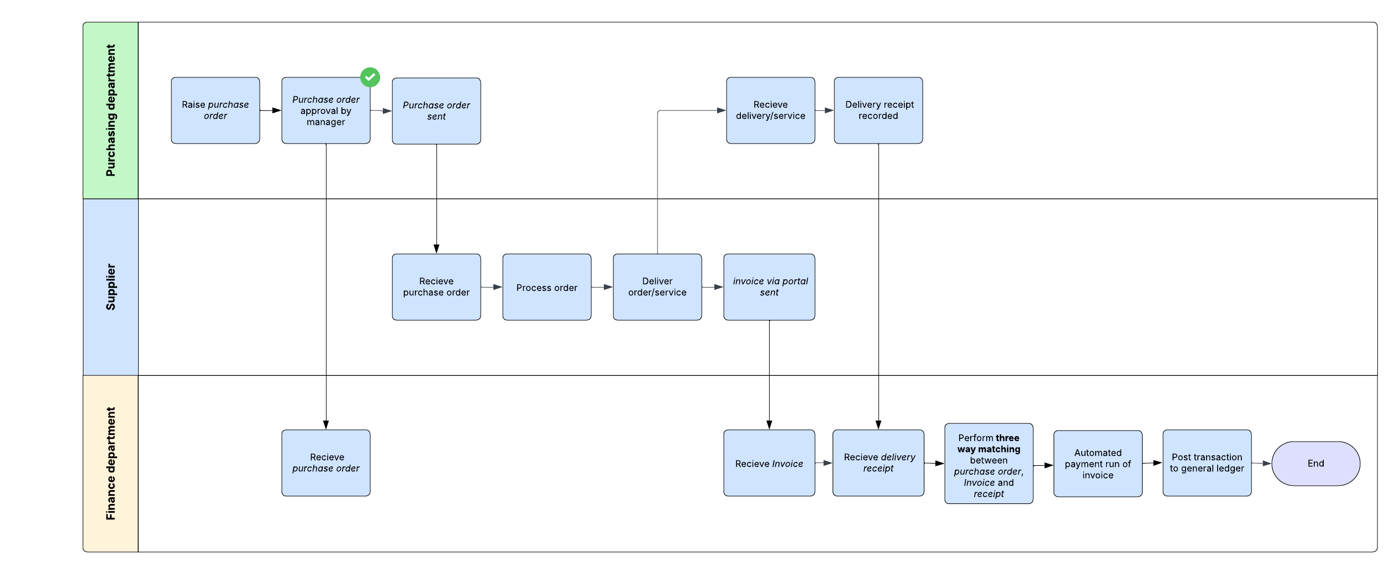
Accounts Payable Business Process 1.1

Slide 4
System Design

Slide 5
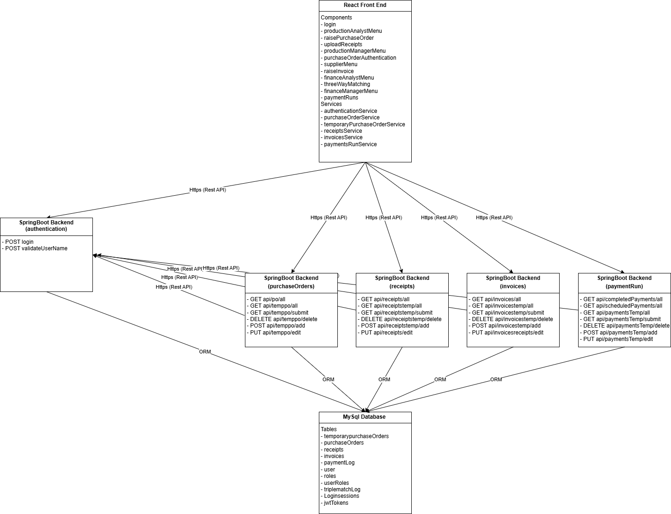
Web Application Component Diagram 1.0

Slide 6
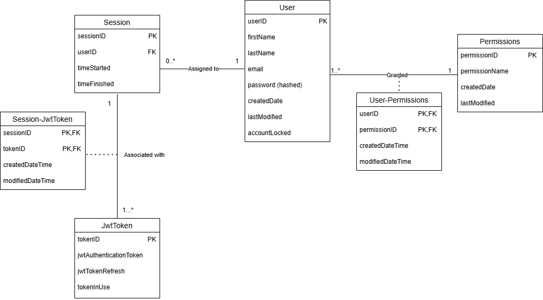
Database Design Diagram – Authentication 1.0

Slide 7
Database Design Diagram - Authentication

Slide 8
API Sequence Diagrams

